Slide 1
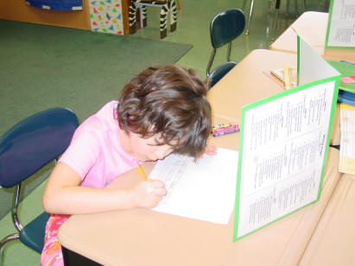
Teaching Writing

Slide 2

Why teach writing?
The main reason for teaching writing is to help students express their thoughts in words. r \
Asma Al-Sayegh

Slide 3
non-compliance with the level of the official letter.
do not always understand the difference between an essay and an article, an autobiography from a resume, email and message
do not demonstrate the variety of means of connectedness of speech (lack of colorful speech, its imagery)

Slide 4
Common writing errors
Spelling mistakes
Violation of logic in writing thoughts
Lexical and grammatical mistakes
Lack of accuracy in calligraphy
Empty outstanding task

Slide 5
Aim: find and reveal possible directions, the general idea of organizing writing
Objectives:
- to study the process of teaching writing at the middle stage of training
- put together teaching methods of writing

Slide 6
The Writing Process
To help students learn and assess writing introduce
The 6 – traits writing model.

Slide 7
The 6 traits of writing
Idea
Organization
Voice
Word choice
Sentence fluency
Conventions

Slide 8

The six traits include:
Ideas: The content, or main theme. Can be looked at as the heart of the message.
Don’t choose too broad topic.
Look for details.

Slide 9
The six traits include:
Organization: The internal structure of the writing.
Good organization helps the reader understands the writer’s message.

Slide 10
The six traits include:
3. Voice: The personal voice of author comes through. This gives a sense of a real person speaking.
Oral reading helps students hear voice.

Slide 11
The six traits include:
Word Choice: The use of precise, colourful and rich words to communicate.
word choice paints pictures in the reader’s mind.

Slide 12
The six traits include:
Sentence Fluency: The writing flows together often with a rhythm or tone.
Good writing plays to the ear,
not just the eye.

Slide 13

The six traits include:
Conventions: Mechanical correctness.
Spelling, punctuation, grammar and usage.

Slide 14
How to teach the Six Traits
Begin with..."What's a trait?“
Immerse students in the language of writers.
2. Ask students to keep a writing folder or journal.
3. Train them to see and hear with critical eyes and ears.

Slide 15
How to teach the Six Traits
4. Ask students to assess others’ work.
5. Ask students to revise others' work.

Slide 16






If I could change one thing in the world ____.

Slide 17
The one thing that really upsets me is..

Slide 18
The qualities of a good friend are …

Slide 19
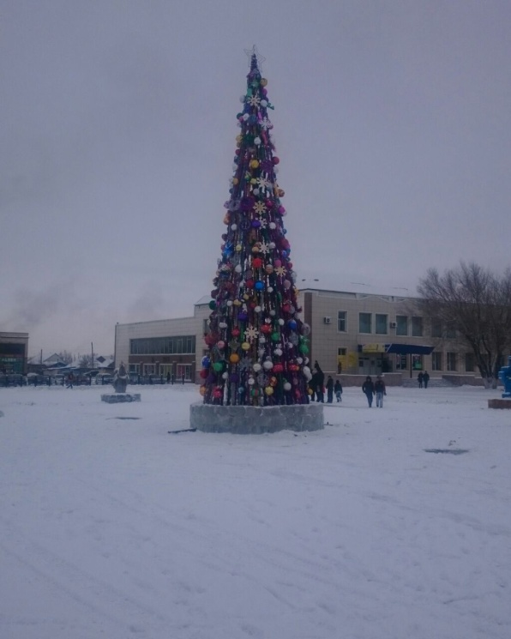
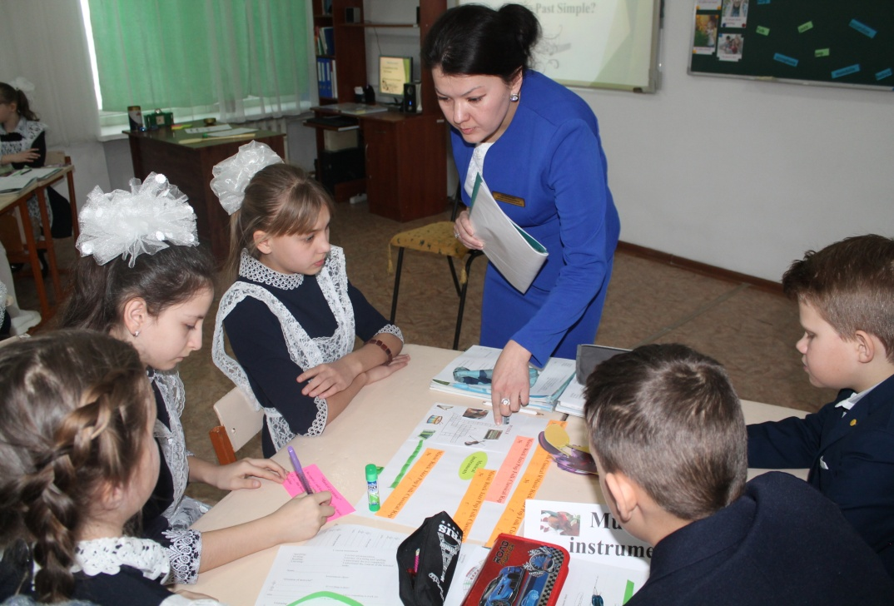
Idea
I live in the city of Atbasar. Our city has a large colorful square, which is especially transformed during the winter holidays. A huge, fluffy, elegant Christmas tree appeared in the center of the square. Colored lights illuminate the Christmas tree. Bright figures of fairy-tale heroes surround a Christmas tree led by Santa Claus and Snow Maiden.

Slide 20
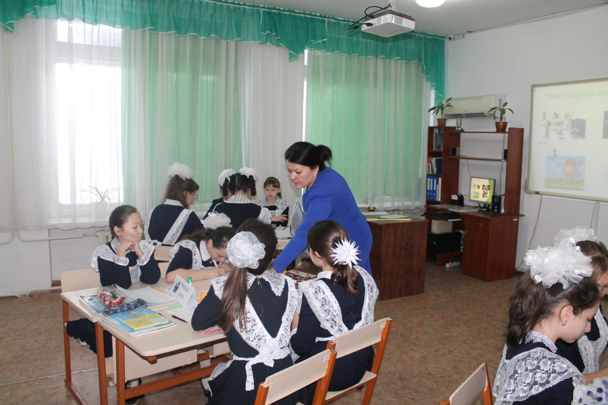
Organization
My friends and I ride from the very height of the hill like snowballs. We laugh, joke and do not notice the winter cold. Most of all we like to take photos next to funny figures of colorful cartoon characters. I believe that the winter holidays are the most unforgettable and fun.

Slide 21
Voice

Slide 22
Word choice
Sentence fluency
Conventions
3 students act as experts, analyzing, evaluating the work of groups

Slide 23
The 6-trait writing model is a way to assess and teach writing. This model focuses on 6 qualities seen in outstanding written works.

Slide 24
Thank you for your attention

